Slide 1

Miles Elementary FY24 Budget Approval Meeting

Slide 2
Norms
This is a meeting of the GO Team. Only members of the team may participate in the discussion. Any members of the public present are here to quietly observe.
We will follow the agenda as noticed to the public and stay on task.
We invite and welcome contributions of every member and listen to each other.
We will respect all ideas and assume good intentions.

Slide 3
Agenda
Action Items
  Approval of Agenda
  Approval of Previous Minutes
  Budget Approval (after final presentation/review and discussion)
Discussion Items
  Presentation of the final budget
Information Items
i. Principal’s Report
ii. BASC-3 Results
    iii. Spring ACES Presentation
Announcements

Slide 4

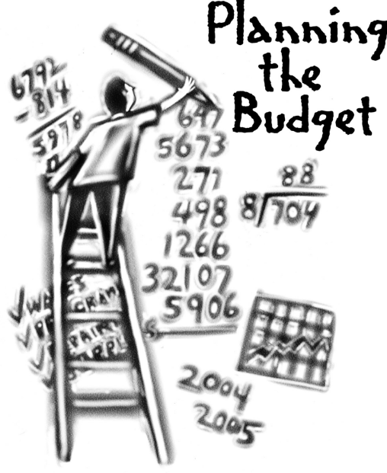
Overview of FY ‘24 GO Team Budget Process
Step 1 Review and Update Strategic Plan and Rank Strategic Priorities
By end of Fall Semester
Step 6 Principals: HR Staffing Conferences Begin
Late February – Early March
Step 3 GO Team Initial Budget Session: Allocation
January 24 – early February
Step 7 GO Team Final Budget Approval Meeting
Budgets Approved by March 17
Step 5
GO Team Feedback Session: Draft Budget Presented & Discussed
February – multiple meetings, if necessary
Step 4 Principals: Associate Supt. Discussions and Review
February (supports needed, specific challenges, coaching)
Step 2 Principals: Workshop FY 24 Budget
January 24, 2023
GO Teams are encouraged to have ongoing conversations about the school’s budget.

Slide 5
Budget Approval Meeting
What
During this meeting GO Teams will review the budget, which should be updated based on feedback from the staffing conference, Associate Superintendents, and key leaders. After review, GO Teams will need to take action (i.e., vote) on the FY24 Budget.
Why
Principals will present the final budget recommendations for GO Team approval.
When
All approval meetings must be held after staffing conferences. Budgets must be approved by March 17th.

Slide 6
Budget Review

Slide 7
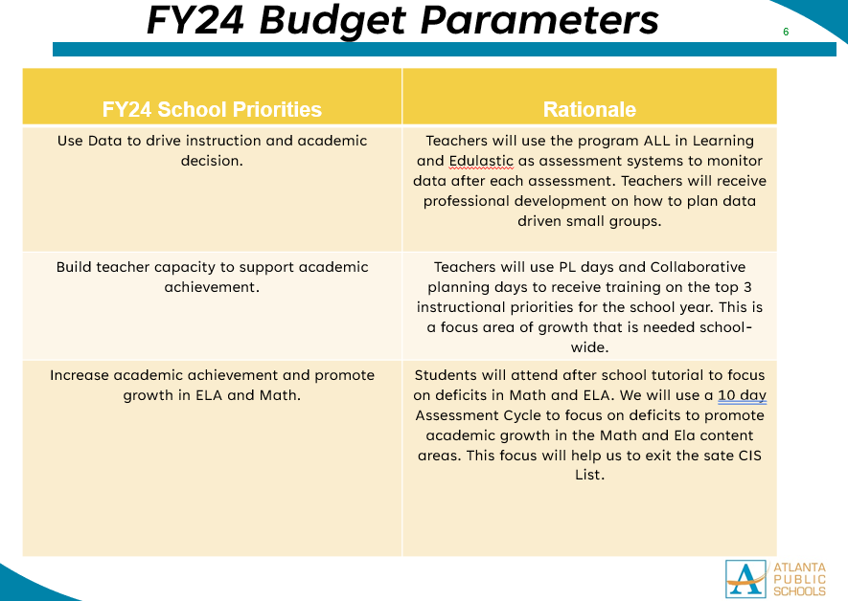

FY24 Budget Parameters
Notes:
Review the priorities that the GO Team has developed and the rationale for these priorities. Feel free to copy this slide if you have more than 3 priorities to account for.

Slide 8
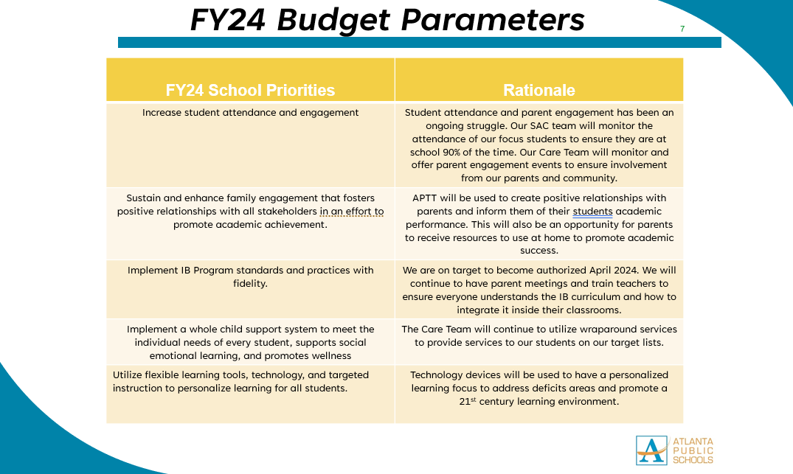

Slide 9
Descriptions of Strategic Plan
Breakout Categories
Priorities: FY24 funding priorities from the school’s strategic plan, ranked by the order of importance.
APS Five Focus Area: What part of the APS Five is the priority aligned to?
Strategies: Lays out specific objectives for school’s improvement.
Request: “The Ask” What needs to be funded in order to support the strategy?
Amount: What is the cost associated with the Request?

Slide 10
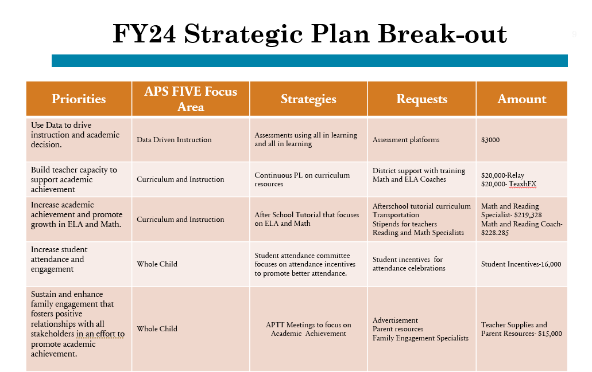
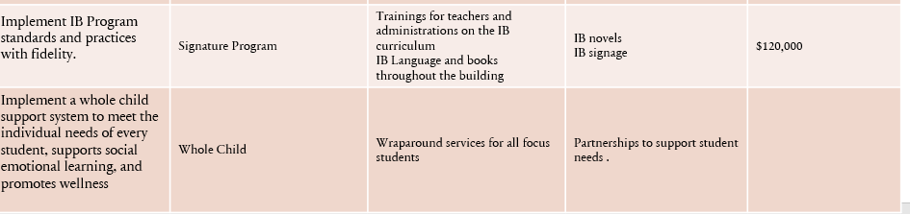
FY24 Strategic Plan Break-out
EXAMPLE
Notes:
For the next few slides, I will show you how I have allocated the budget to support our strategic priorities.
Based on our strategic priorities and funds we received, here is a break-out of the priorities, which focus area it addresses, the strategies that will be implemented, the purchase request, which funding source was used and the amount.

Slide 11
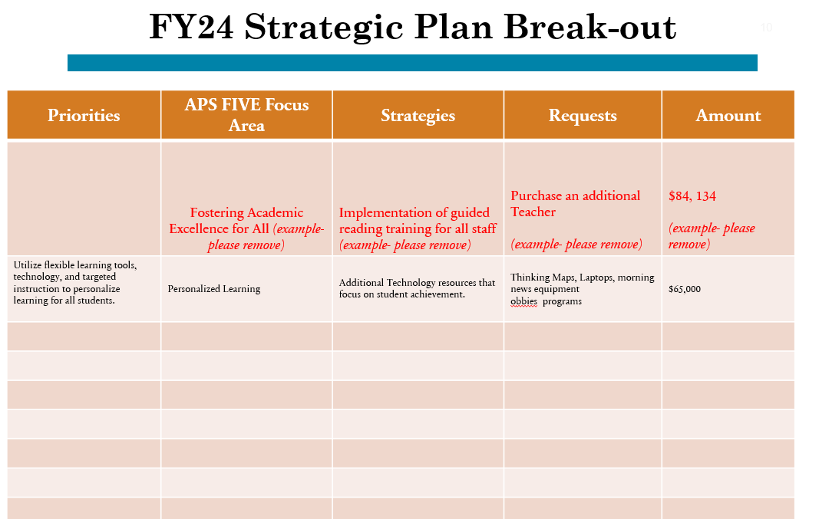
FY24 Strategic Plan Break-out
EXAMPLE
Notes:
For the next few slides, I will show you how I have allocated the budget to support our strategic priorities.
Based on our strategic priorities and funds we received, here is a break-out of the priorities, which focus area it addresses, the strategies that will be implemented, the purchase request, which funding source was used and the amount.

Slide 12
Plan for FY24 CARES Allocation $(238,674)___
Priorities | APS FIVE Focus Area | Strategies | Requests | Amount
Utilize a master teacher leader to build teacher capacity | Curriculum and Instruction | Use master teacher to build capacity with developing tier I instruction | One teacher | $91,469
Create 21st Century media center | Personalized Learning | Create a personalized learning environment where students can track data and monitor lexile scores | Media equipment | $46,109
Teacher Supplies and student incentives | Whole Child | Incentives students for meeting academic and behavior goals Supplies for teachers to incentives students weekly |  | $6,391
Notes:
For the next few slides, I will show you how I have allocated the budget to support our strategic priorities.
Based on our strategic priorities and funds we received, here is a break-out of the priorities, which focus area it addresses, the strategies that will be implemented, the purchase request, which funding source was used and the amount.

Slide 13
Plan for FY24 Title I Family Engagement Funds
$___(11,000)___
Priorities | APS FIVE Focus Area | Strategies | Requests | Amount
Parent resource center | Whole Child | Create a parent resource area with books, computers, resume building, and tools parents may need to assist them with daily living |  | $7,000
Transportation for parent meetings | Whole Child | Transportation to APTT Meetings and any school events to increase parent engagement |  | $1,000
Resources needed for APTT Meetings | Whole Child | Curricular supplies such as work bookies, instructional packets, manipulatives, flyers, advertisement |  | $2,000
Notes:
For the next few slides, I will show you how I have allocated the budget to support our strategic priorities.
Based on our strategic priorities and funds we received, here is a break-out of the priorities, which focus area it addresses, the strategies that will be implemented, the purchase request, which funding source was used and the amount.

Slide 14

Staffing Conference Changes
.Changes Made
Turnaround Reading Specialist
Turnaround Math Specialist
Math Coach
Reading Coach
RTI Specialist
EIP Teacher
Music Teacher Full time
Engagement Specialist
Non-Instructional Para(Behavior)
Sped Paras for an increase in SPED case load
Assistant Principal
Turnaround Counselor
There were changes made to the draft budget we discussed at our last meeting.
These changes reflect an allocation change of +/- $1,220,778

Slide 15
Summary of Changes
Change at Staffing Conference | Impact to Proposed Budget
.Changes Made Turnaround Reading Specialist Turnaround Math Specialist Math Coach Reading Coach RTI Specialist EIP Teacher Music Teacher Full time Engagement Specialist Non-Instructional Para(Behavior) Sped Paras for an increase in SPED case load Assistant Principal Turnaround Counselor | $1, 220, 778

Slide 16
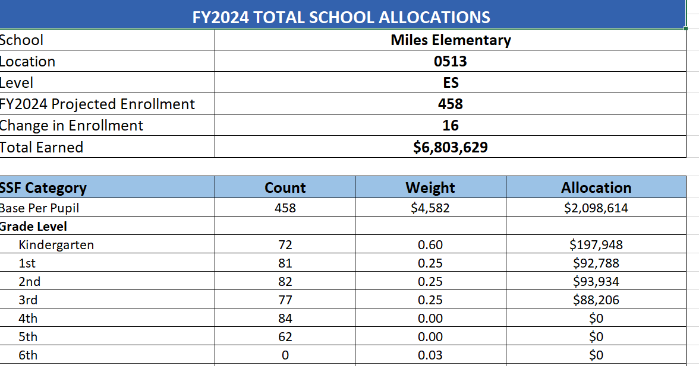
Budget by Function (Required)
*Based on Current Allocation of School Budget

Slide 17
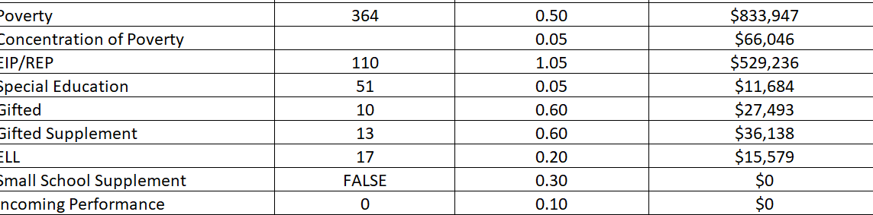

Slide 18
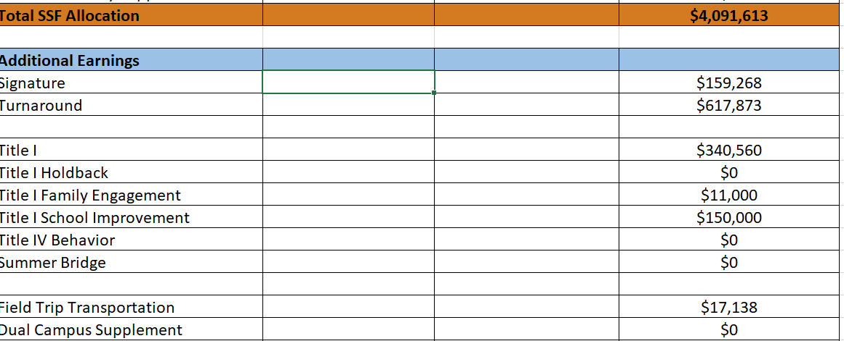

Slide 19
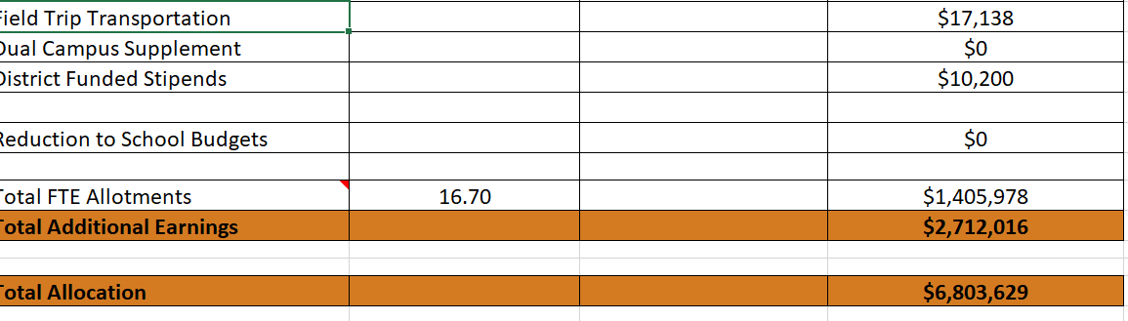

Slide 20
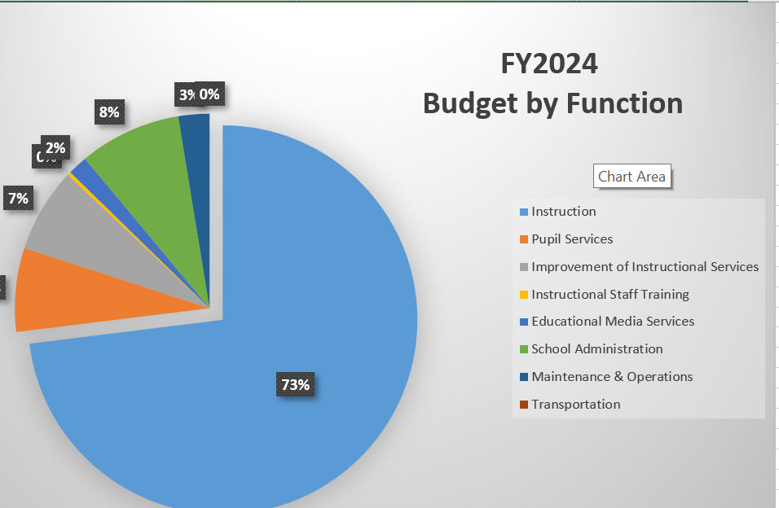
Budget by Function (Required)
*Based on Current Allocation of School Budget

Slide 21
Discussion of reserve and Holdback funds

Slide 22
Plan for FY24 Leveling Reserve
$__(81,832)___
Implementation of guided reading training for all staff (example- please remove) | Purchase an additional Teacher (example- please remove) | $84, 134 (example- please remove) | Requests | Amount
Increase instructional support for small groups | Curriculum and Instruction | Support for small groups | Purchas two additional paras to service 3rd and 4th grades | 81,832
Notes:
For the next few slides, I will show you how I have allocated the budget to support our strategic priorities.
Based on our strategic priorities and funds we received, here is a break-out of the priorities, which focus area it addresses, the strategies that will be implemented, the purchase request, which funding source was used and the amount.

Slide 23
Plan for FY24 Title I Holdback $___(0)___
Priorities | APS FIVE Focus Area | Strategies | Requests | Amount
Increase level of rigor and relevance (example- please remove) | Fostering Academic Excellence for All (example- please remove) | Implementation of guided reading training for all staff (example- please remove) | Purchase an additional Teacher (example- please remove) | $84, 134 (example- please remove)
EXAMPLE
Notes:
For the next few slides, I will show you how I have allocated the budget to support our strategic priorities.
Based on our strategic priorities and funds we received, here is a break-out of the priorities, which focus area it addresses, the strategies that will be implemented, the purchase request, which funding source was used and the amount.

Slide 24
Questions for the GO Team to Consider and Discuss
Are our school’s priorities (from your strategic plan) reflected in this budget?
Are new positions and/or resources included in the budget to address our major priorities?
Do we know (as a team) the plan to support implementation of these priorities beyond the budget (ex. What strategies will be implemented)?
What tradeoffs are being made in order to support these priorities?
How are district and cluster priorities reflected in our budget?
Cluster priorities- what staff, materials, etc. are dedicated to supporting our cluster’s priorities?
Signature programs- what staff, materials, etc. are dedicated to supporting our signature program?
Are there positions our school will share with another school, e.g. nurse, counselor?
Notes:
CHAIR - Our final task for today! Here are questions that we need to consider to ensure we have a good working draft budget. Let’s walk through them together.

Slide 25

Questions?

Slide 26
The GO Team needs to TAKE ACTION (vote) on the presented budget. After the motion and a second, the GO Team may have additional discussion. Once discussion is concluded, the GO Team will vote.
Action on the Budget

Slide 27

BASC-3 Data

Slide 28
Insert BASC-3 data if available – use as many slides as necessary

Slide 29

2023 Spring ACES
NOTE to Principal: Please insert your Spring ACES presentation after this slide.
Accountability
Collaboration
Equity
Support

Slide 31
Questions?

Slide 32

Thank you

